Slide 1
Introduction to DOM (Document Object Model)
What is DOM?
Why do we use it?
DOM = Structure of a webpage represented as a tree.

Slide 2
What is the DOM?
DOM = Browser’s representation of HTML.
Every HTML element becomes a node.
JavaScript can:
Access
Modify
Add
Delete HTML elements using the DOM.

Slide 3
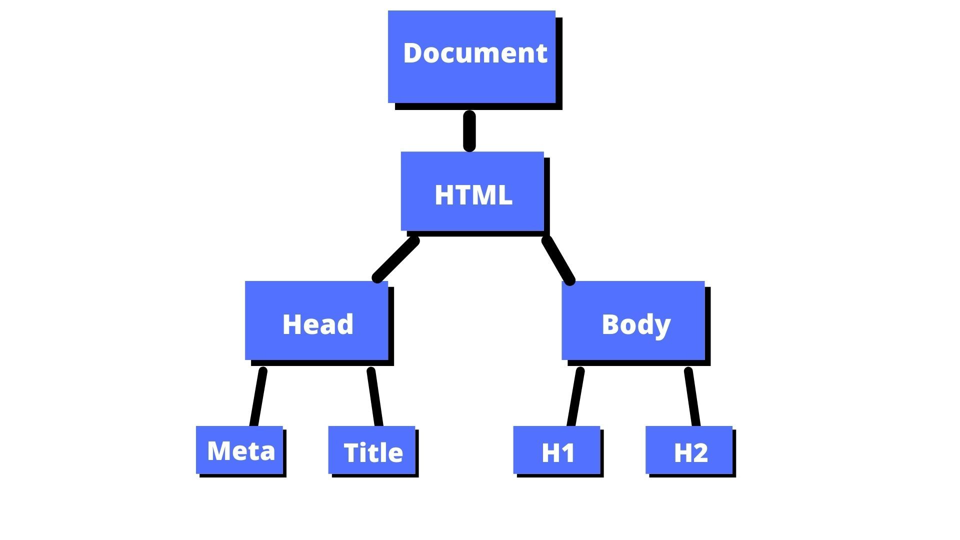
DOM Tree Visual

Slide 4
Accessing Elements
document.getElementById("id")
Returns a single element.
Fastest method.

Slide 5
Accessing Elements
document.getElementsByClassName("class")
Returns HTMLCollection
Not an array (but looks like one).

Slide 6
Accessing Elements
document.querySelector("selector")
Returns the first matched element.
Can use:
#id
.class
tag
Complex CSS selectors

Slide 7
Accessing Elements
document.querySelectorAll("selector")
Returns NodeList
NodeList = array-like + supports forEach

Slide 8


Changing Content
Using innerText
Gets/sets visible text.
Using innerHTML
Gets/sets HTML code inside element.

Slide 9

Changing CSS (Inline Styles)
via .style.property
Important: CSS uses camelCase in JS

Slide 10
Adding / Removing Classes
classList Methods
element.classList.add("className")
element.classList.remove("className")
element.classList.toggle("className")

Slide 11
Creating Elements
document.createElement()

Slide 12
Appending Elements
Methods:
parent.appendChild(newElement)
parent.append(newElement)
parent.prepend(newElement)

Slide 13



Accessing Parent, Children, Siblings
Children
Parent
Siblings

